Slide 1
BDAGROUP1A: Simply Care
Allison Hall, Caleb Smith, Emma de la Torre, and Santiago Diacono
103
What is it?
Simply care is an app designed to make healthcare as accessible and as customizable as possible. We believe that healthcare doesn’t come in a standardized box.
Target Audience
While our app is designed for everyone our focus is on those who are 55 years and older
Data Used
The data that we utilized in our project was a combination data sets and peer reviewed articles that outline the disparities of elderly using mobile phone applications
Themes Addressed
The hackathon themes that we are tackling are patience experience, mobile, and health disparities.

Slide 2
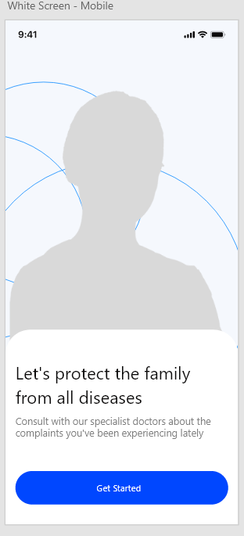
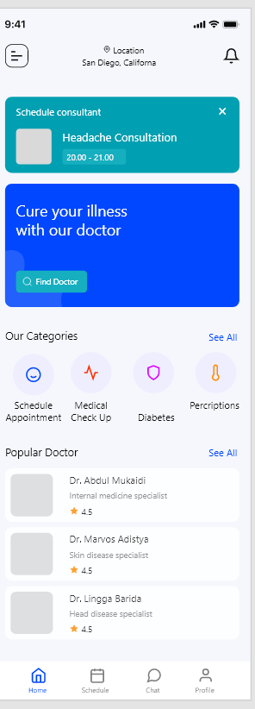
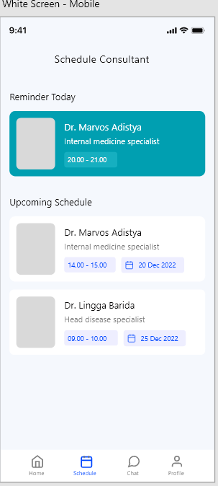
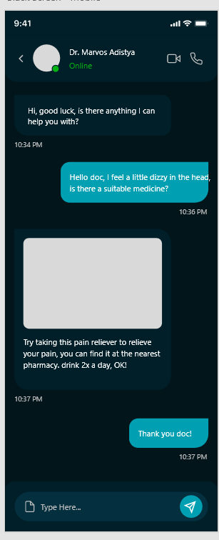
103
How our team came together, and a plan for future development
Our team works together in BDA594 (taught by Prof. Tsou), and we plan to continue brainstorming and development for the future of this project
With additional time for UI design and coding to flush out the product, it is relatively ready to move out to market.
*Mock Up of Simply Care

